Slide 1


Environment
Economics
Equity

Slide 2


Slide 3


Technical Architecture
Utility Bills (PDF)
Monthly
NOAA Weather Data
Tools
Tabula
+ CRON
RNN Predictive Model
Mean Absolute percentage Error (mape) 4.868%
MS Azure + Databricks for Model Development
Incoming Electricity Data
30 min. increments
Air Compressor Data
15 min increments
Github – Source Control + Collaboration
(3) Ovens Electricity Data
Current, Volts
Headless CMS
VS Code
Excel
Barcode Scanner Data for Ovens
1 unit per cycle
REST API
Relay Control or PLC to Switch/Add Battery Power Automatically
Opens Opportunity for external Integration
Dashboard
Notes:
Noel
Let’s begin with discussing the data you have available. First, you will have data regarding the incoming electricity to the plant in 30 minutes intervals. This is provided by our utility company. From the utility bills, we can derive a 'blended rate' for the cost of energy consumed – given all of the variable billing components and the total energy consumed, what was the final cost per kWh?
We also have energy data from a handful of machines: an air compressor, and three ovens. Given the blended energy cost rate, we can calculate a rough approximation of the cost of the energy consumed by those machines during the billing cycle covered by the bill.
We also have data from a barcode scanner, which tells us when items enter the oven. This data will give us insight into the energy profile of the machine when units enter the oven versus when they are not entering the oven. This will enable you to determine the state of each piece of equipment, while also understanding it’s OEEE.
From there, you will analyze the data with additional data sources (like the utility bills we provided and additional 3rd party data not provided, such as weather data for calculating heating and cooling degree days) to create real-time—and forecasted—cost and emissions insights. The results of your findings will then be displayed on an intuitive dashboard sharing real-time present and forecasted insights.

Slide 4

Dashboard

Slide 5

Dashboard
Easy
Streamlined
Powerful

Slide 6

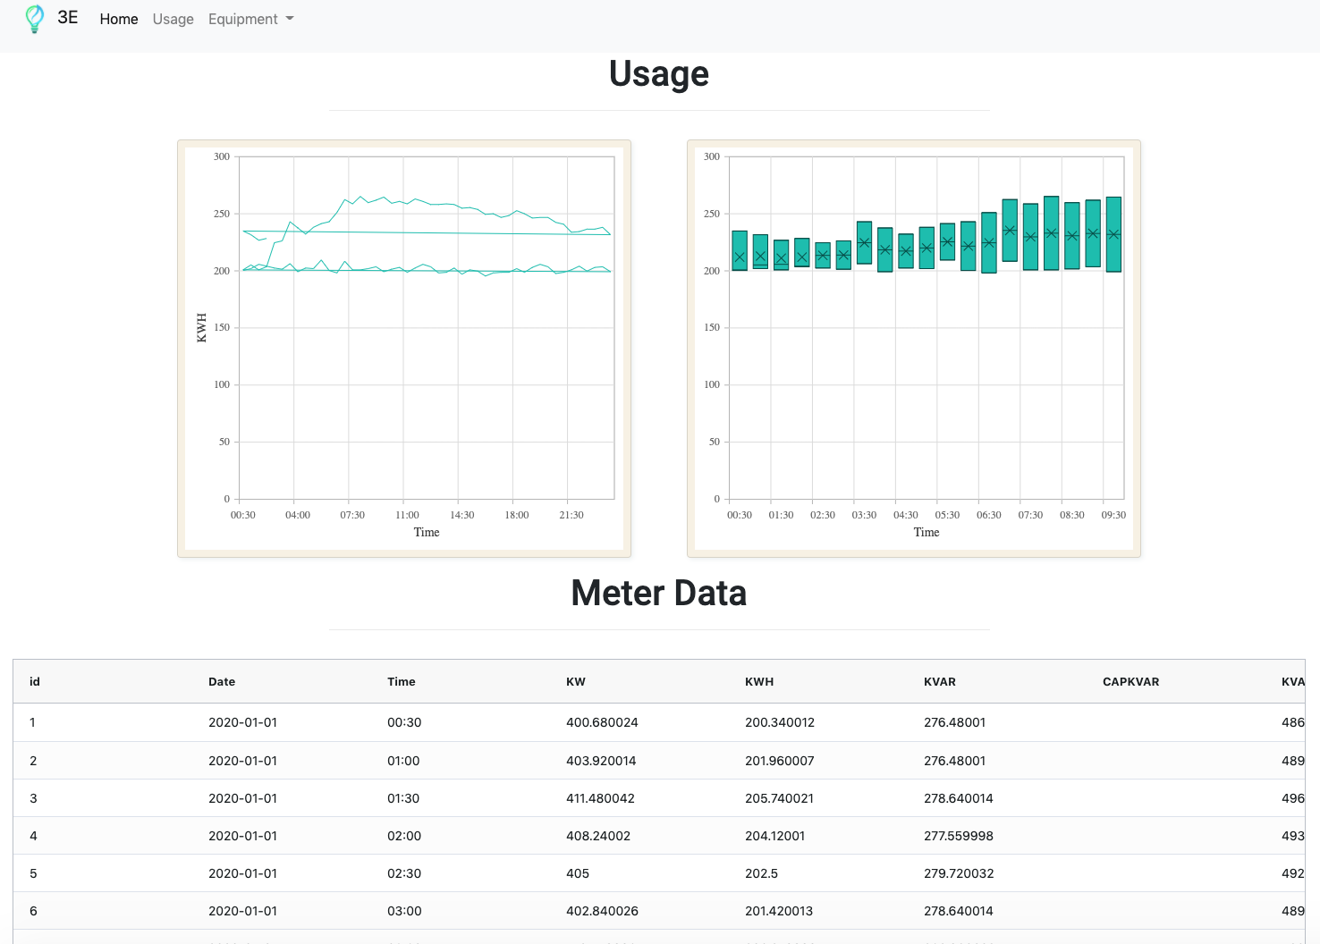
Charts

Slide 7
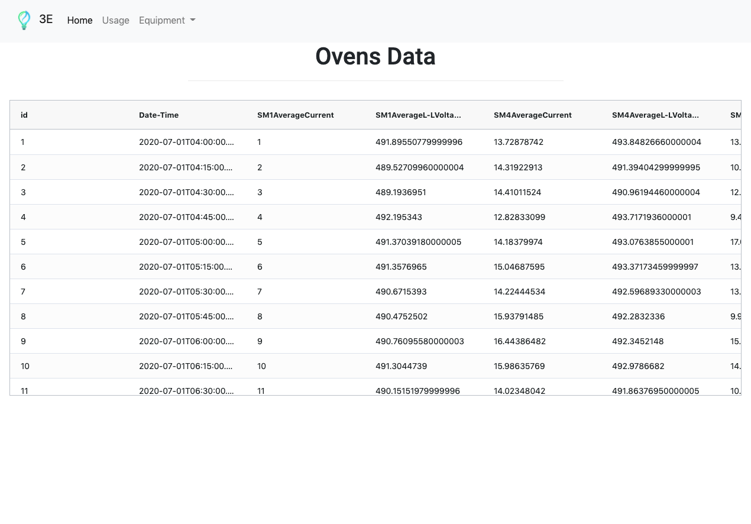
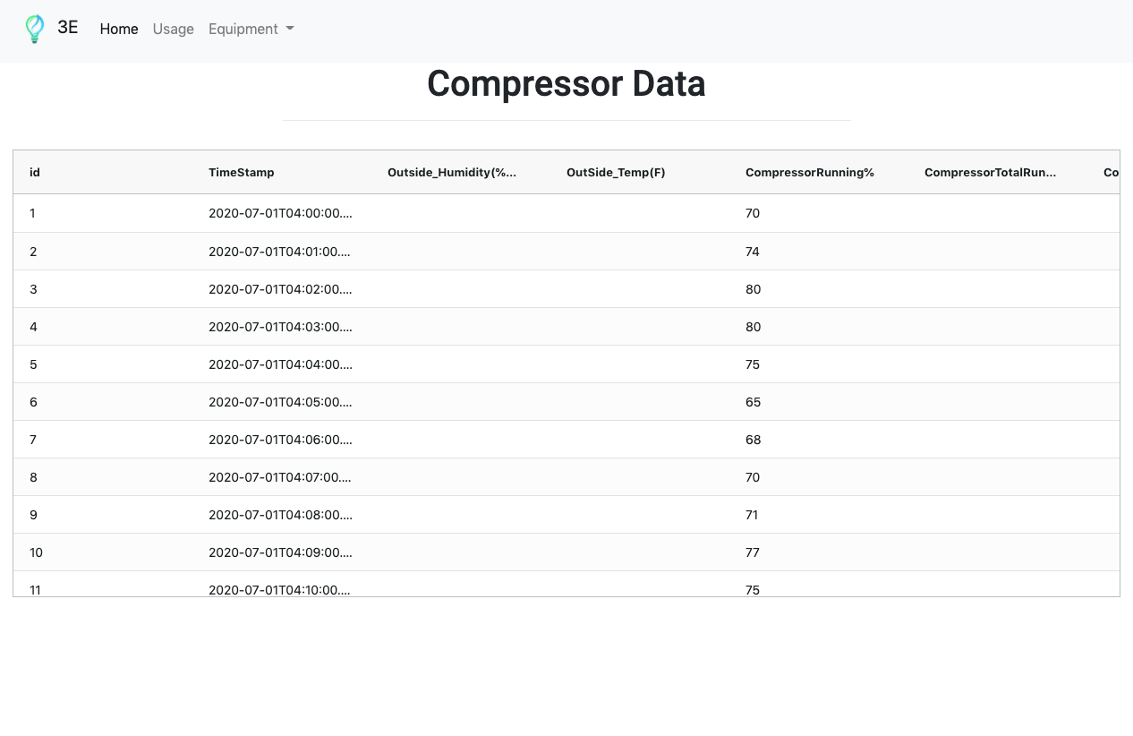
Equipment Monitoring

Slide 8
Data Analysis

Slide 9
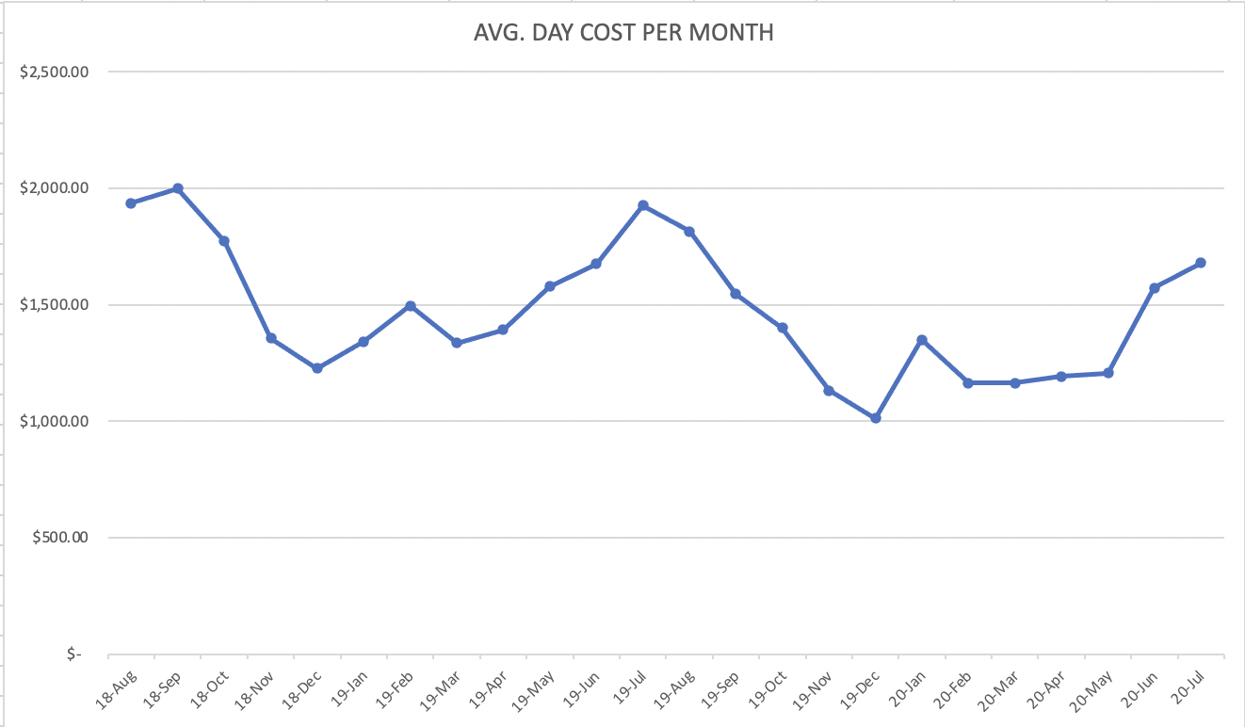
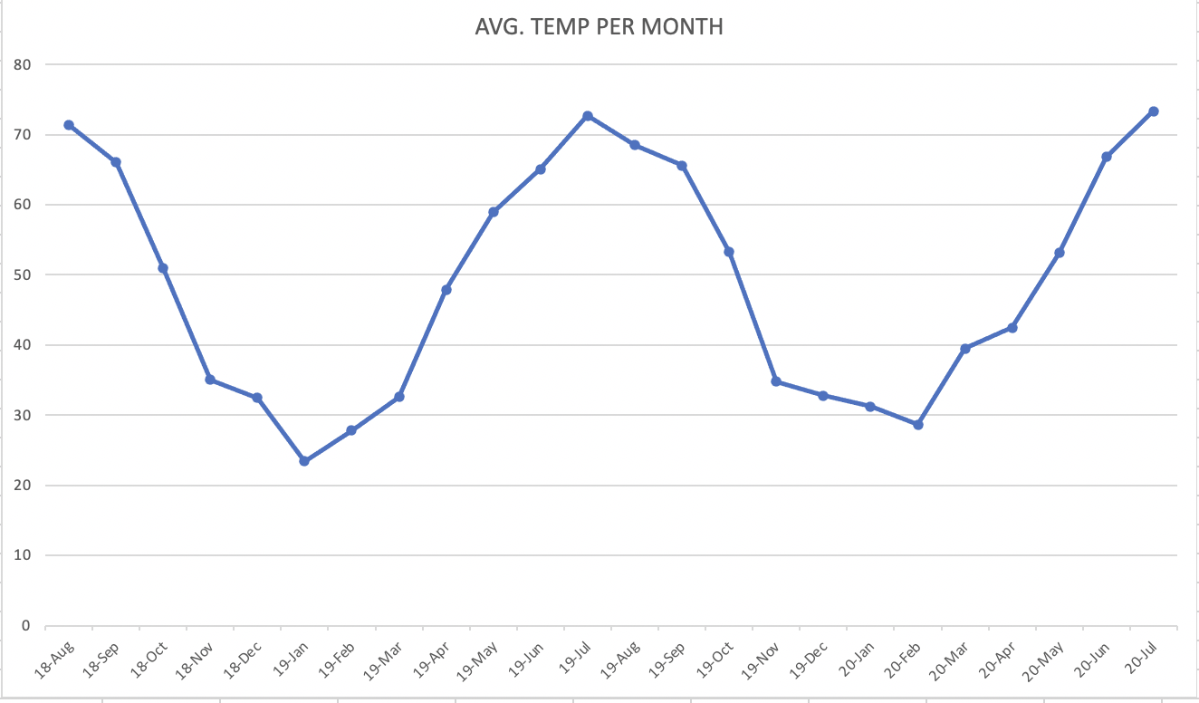
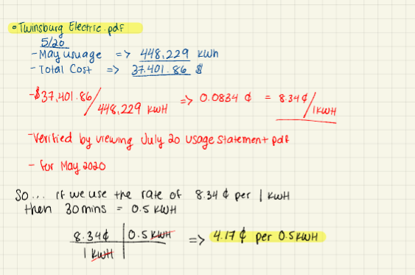
Understanding the Challenge and Data
Utilities Perspective
Used Python/Tabula to Convert PDF to CSV for July 20 Usage Statement –
Clean up using Excel – Fix Dates, Format
Possible Connection Between Average Day Cost Per Month & The Average Temperature Per Month

Slide 10
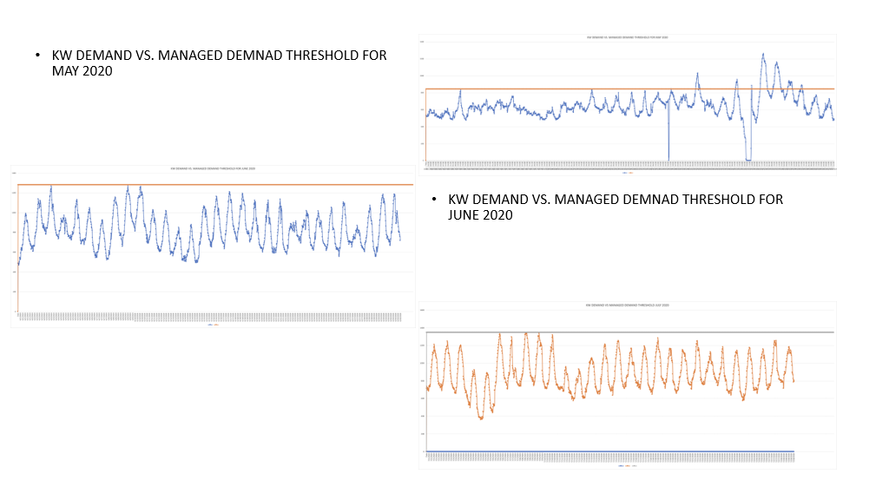

Slide 11
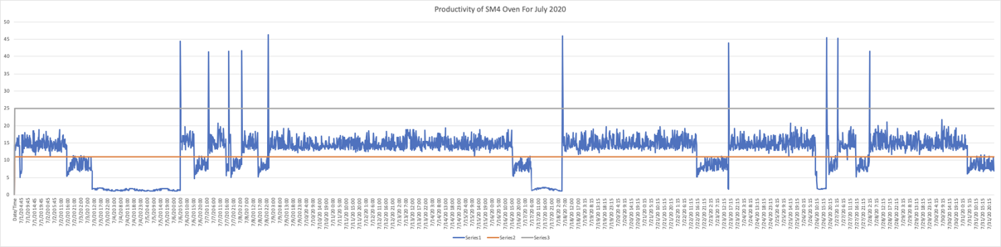
Productivity of SM4 Oven for July 2020​
Showing Productivity 11- 25 ​

Slide 12
Data Analysis

Slide 13
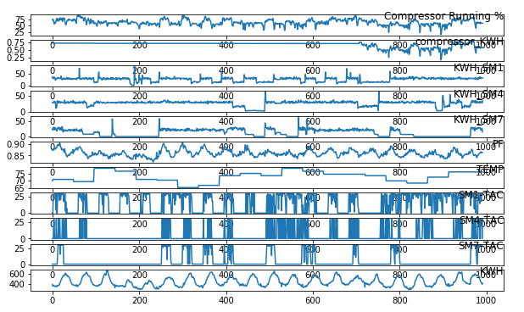
Understanding data (July)
The file provides data for energy usage of three ovens (SM1, SM4, SM7):
Average current per 15 min
Average voltage per 15 min
Extract Energy
= V *I*t

Slide 14
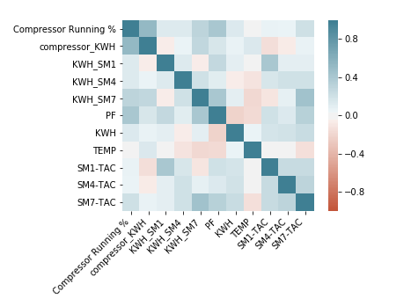
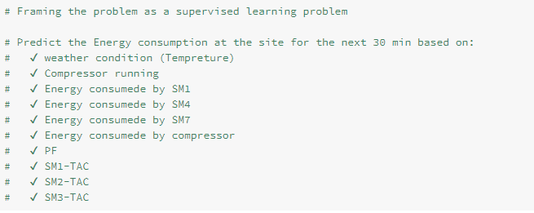
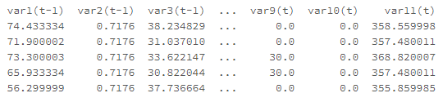
Variables used in model development
The file provides per min data of:

Slide 15
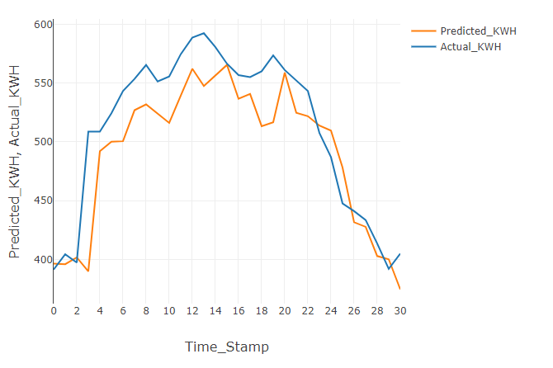
Prediction
The file provides Information about the three ovens (SM1, SM4, SM7)

Slide 16
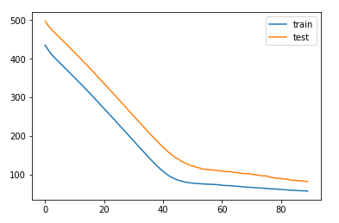
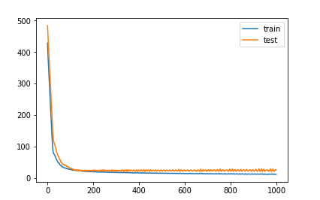
Training an RNN (LSTM) model
Model features

Slide 17
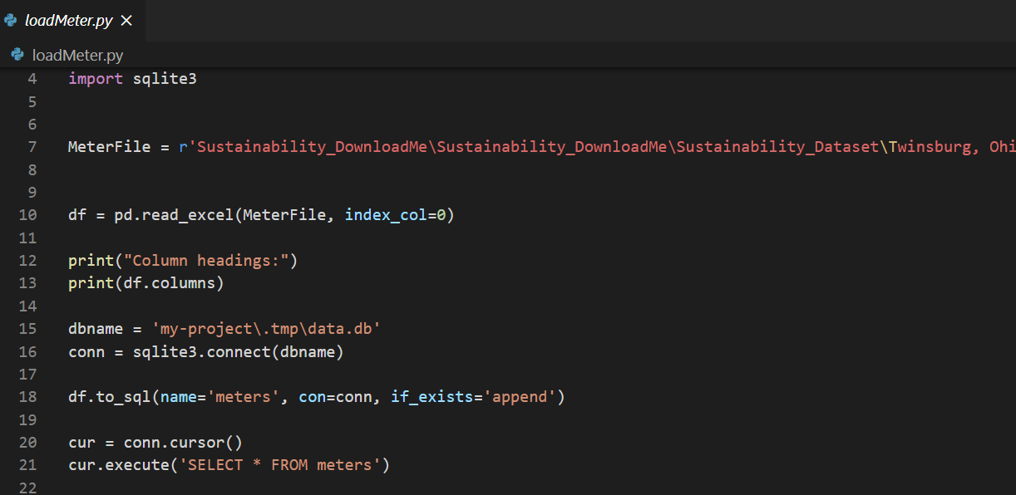
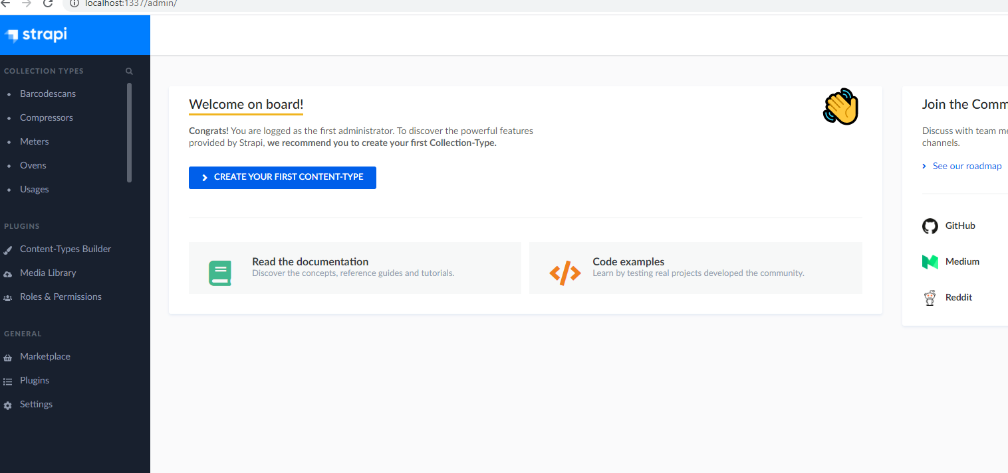
Headless CMS Admin Inerface

Slide 18
Thank You

